Slide 1
Judaism
Beliefs
• beliefs about God
• nature of human beings: yetzer tov; yetzer harah; free will; suffering
• beliefs about Covenant
• judgement; the Messiah; the Messianic Age; Olam Ha’ba
Practices
• living according to the Commandments
• Rosh Hashanah; Yom Kippur
• worship: Shabbat; synagogue

Slide 2

Jewish people believe certain things and this impacts their behaviour.
This can be called their BELIEF and their PRACTICE.
Think of it like a tree!

Slide 3

Practice
Belief

Slide 4

Here are some beliefs, but what are the actions (practices) that will follow?
All animals are of value.
What other people think matters.
Trust no one.
The devil is real.
We have a responsibility to care for the planet.
Money brings happiness.
Everyone should own a gun to protect themselves.
All children should receive free school meals.
Never start anything new on a Friday!
Talk to the people around you about each belief, think what actions do we see from someone who believes this?

Slide 5

There are two main branches of Judaism
1: Orthodox
Orthodox, or Observant, is the name given to a Jew who strictly follows their faith and is careful to follow all the laws laid down for them in their religion.
2: Reform
Reform Judaism can also be known as Liberal or Progressive Judaism and it started in Germany in the early 19th Century.
It has its own synagogues and prayer book.
Reform groups are larger in size than Orthodox Judaism worldwide.

Slide 6
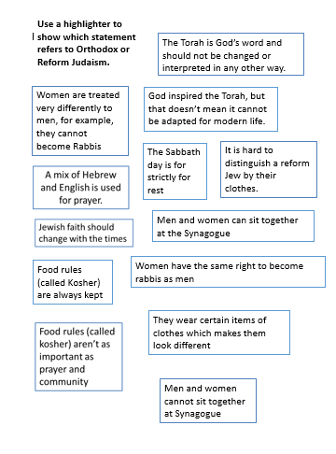
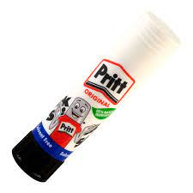
Glue the worksheet into your jotters.
As we learn about Orthodox and Reform Judaism highlight the correct box for each one.

Slide 7
What is distinctive about Orthodox Judaism ?
The Torah is God’s word and should not be changed or interpreted in any other way.
The Sabbath day is for strictly for rest
Women are treated very differently to men, for example, they cannot become Rabbis
Food rules (called Kosher) are always kept
Orthodox
They wear certain items of clothes which makes them look different
https://www.bing.com/videos/search?q=Orthodox+Judaism+Explained&&view=detail&mid=CFDB45D505F4A3D56FBFCFDB45D505F4A3D56FBF&&FORM=VRDGAR
Men and women cannot sit together at Synagogue

Slide 8
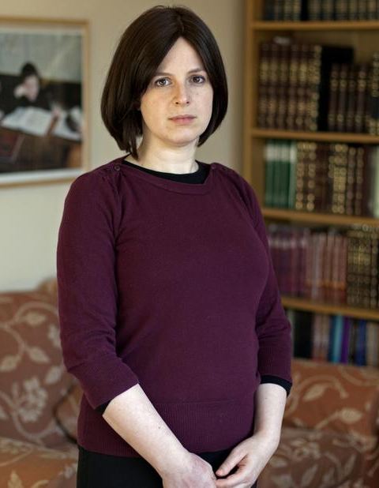
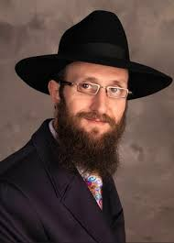
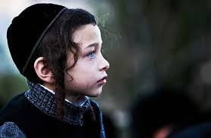
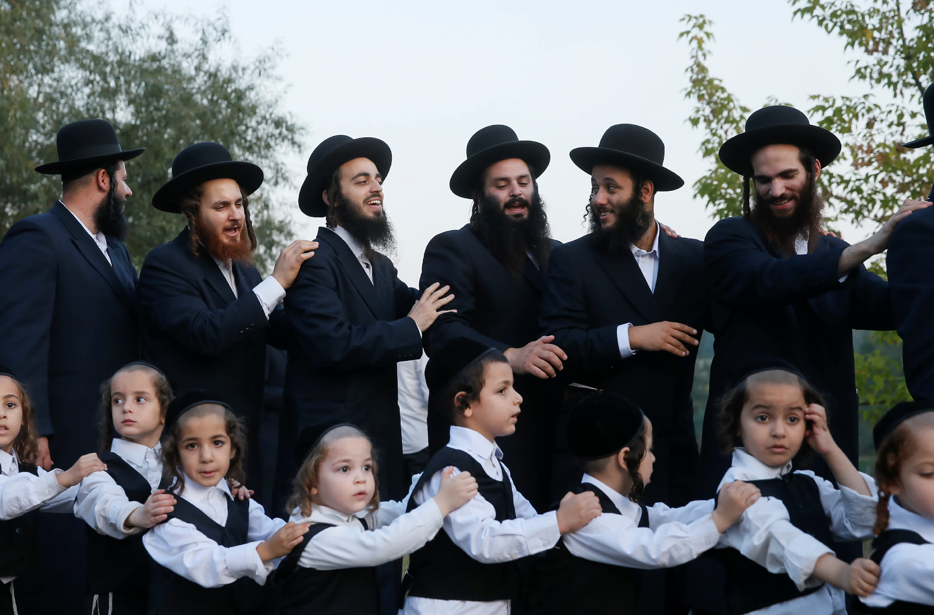
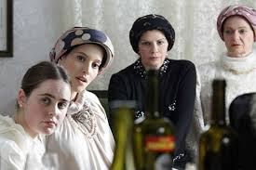

Slide 9
What is distinctive about Reform Judaism ?
https://reformjudaism.org/what-reform-judaism
God inspired the Torah, but that doesn’t mean it cannot be adapted for modern life.
Jewish faith should change with the times.
Food rules (called kosher) aren’t as important as prayer and community.
Women the same right to become rabbis as men.
Reform
Men and women CAN sit together at Synagogue.
It is hard to distinguish a reform Jew by their clothes.
A mix of Hebrew and English is used for prayer.

Slide 10
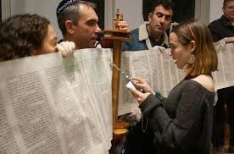
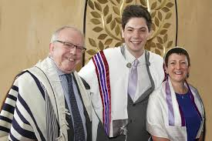
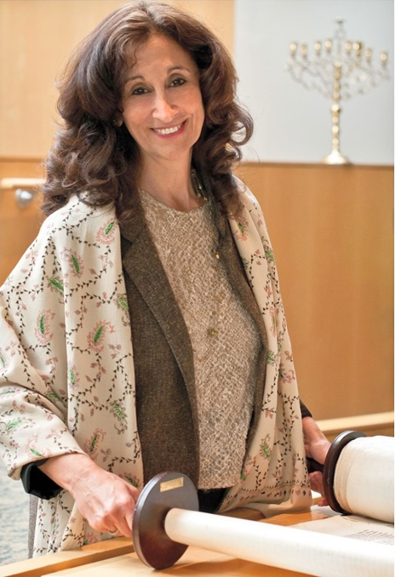
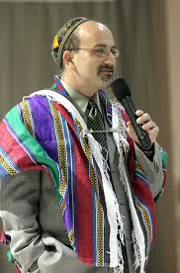
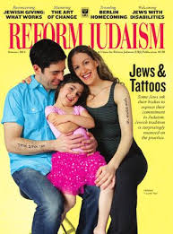

Slide 11
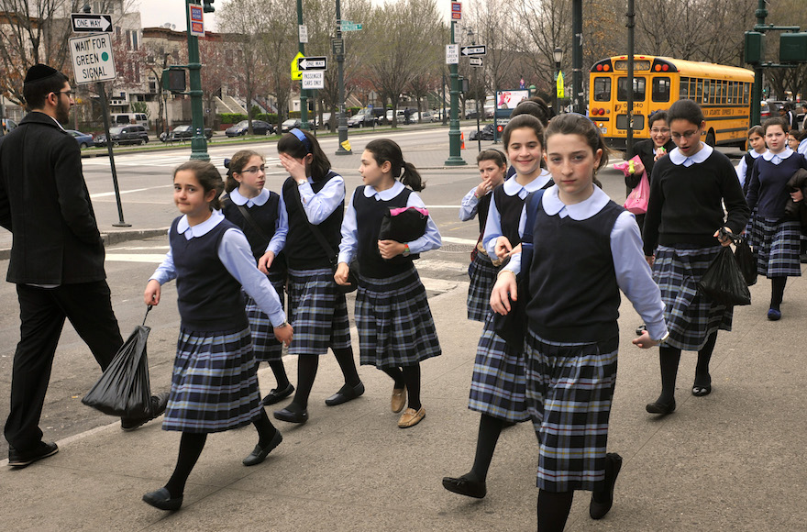
Statistics
According to the 2011 British census, 271,259 people answered "Jewish" to the voluntary question on religion.
A report taken after the census found that the strictly Orthodox community sits at 16%
But it is growing while the number of reform Jews is declining.
“The strictly orthodox population is significantly younger and growing at a faster rate than the non-strictly orthodox,” the report says.

Slide 12

This is true in the USA too, take a look at this article.
https://www.washingtonpost.com/religion/2021/05/11/orthodox-jews-poll-secular-trump-republican/
Why?
This is partly to do with a higher growth rate and partly to do with people seeking a sense of community.

Slide 13
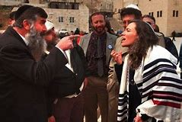

Task:
Get into character!
Divide yourselves into pairs.
One person is an Orthodox Jew and the other is a Reform Jew.
How can you explain and justify your position?
Be polite and respectful and listen to each other but come up with your arguments for your viewpoint.

